Slide 1

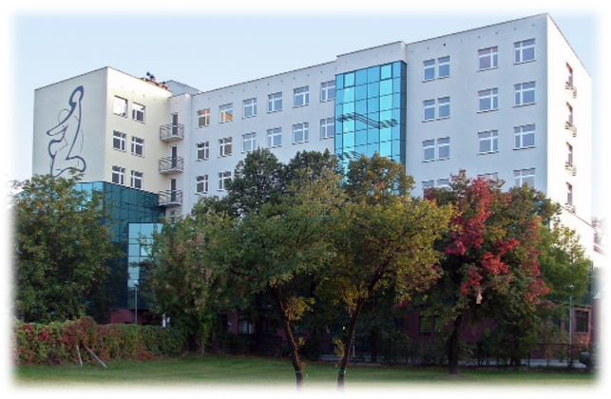
IV INTERNATIONAL RESEARCH AND TRAINING CONFERENCE ON PSYCHOLOGICAL HELP METHODS:
“On crisis intervention”
CONFERENCE ANNOUNCEMENT No. 1
The Maria Grzegorzewska University (APS),
Warsaw, Poland
Institute of Psychology
Department of Psychotherapy and Psychological Counseling
40 Szczęśliwicka Street
02-353 Warsaw
Conference e-mail:
metodypomocy@aps.edu.pl
Facebook:
facebook.com/metodypomocy
Event click
Organisation for this edition:
Department of Psychotherapy and Psychological Counseling, Institute of Psychology, APS.
The International Research and Training Conference on Psychological Help Methods is a recurring event, following previous editions held in 2019, 2021, and 2023. Its primary goal is to disseminate knowledge about various forms of psychological assistance, their applications, and their effectiveness in supporting different recipient groups.
During this event, the academic community meets with practitioners who provide psychological help daily. Such research and training meetings create an opportunity to refine and promote the most effective interventions used by psychologists, psychotherapists, and other professionals in helping professions.
In 2025, we aim to focus on crisis intervention as a form of psychological support. The 2020s are referred to as a time of multiple crises, influenced by the recent COVID-19 pandemic, the ongoing war in Ukraine, as well as armed conflicts in other regions of the world, economic instability, and the climate crisis. These situations not only come as a surprise but also demand new coping strategies. At times, the crisis experienced by an individual is so severe that overcoming it requires external assistance. Crisis intervention is a form of support aimed at providing individuals with short-term aid through an interdisciplinary team, helping them regain their ability to manage their situation independently.
The conference will facilitate knowledge exchange and discussions on the latest research and practices related to crisis intervention.
Previous editions of the conference have garnered significant interest from both the scientific community and professionals in the field of psychological assistance (with 200 participants in 2019 and 2023, and 150 participants in 2021, which was held online due to the pandemic). We hope that this time, too, we will come together to share our knowledge and experiences!
Conference date:
November 13-14, 2025
Form:
On-site event, including lectures and workshops at the APS headquarters in Warsaw.
Plenary sessions will be held in Polish and English. Workshops and parallel sessions will be conducted in either Polish or English.
Conference fee:
500 PLN.

Slide 2
IV INTERNATIONAL RESEARCH AND TRAINING CONFERENCE ON PSYCHOLOGICAL HELP METHODS:
“On crisis intervention”
CONFERENCE ANNOUNCEMENT No. 1
THE TOPICS WE PLAN TO ADDRESS DURING THE CONFERENCE INCLUDE, AMONG OTHERS:
  Crisis intervention in cases of domestic violence
  Crisis intervention in the context of loss and grief
  Crisis intervention in the aftermath of disasters and natural catastrophes
  Crisis intervention in supporting migrants and war refugees
  Crisis intervention in the context of chronic illness and disability diagnosis
  Training in the field of crisis intervention
Scientific Committee of the Conference
  Prof. Czesław Czabała,
  Prof. Irena Jelonkiewicz,
  Prof. Katarzyna Prot-Klinger,
  Prof. Marcin Sękowski,
  Dr Krzysztof Ciepliński,
  Dr Sylwia Kluczyńska,
  Dr Iwona Nowakowska,
  Dr Lidia Zabłocka-Żytka,
  Mgr Izabela Pawłowska,
  Mgr Anna Zarazińska-Chromińska.
Organizing Committee of the Conference
  Prof. Irena Jelonkiewicz,
  Prof. Marcin Sękowski,
  Dr Krzysztof Ciepliński,
  Dr Sylwia Kluczyńska,
  Dr Iwona Nowakowska,
  Dr Lidia Zabłocka-Żytka,
  Mgr Izabela Pawłowska,
  Mgr Anna Zarazińska-Chromińska.
WE INVITE YOU!
Registration: https://konferencje.aps.edu.pl/metodypomocy-4

